Slide 1
CS 1070 Final
Heart Failure Prediction
By Tony Kamgaing

Slide 2
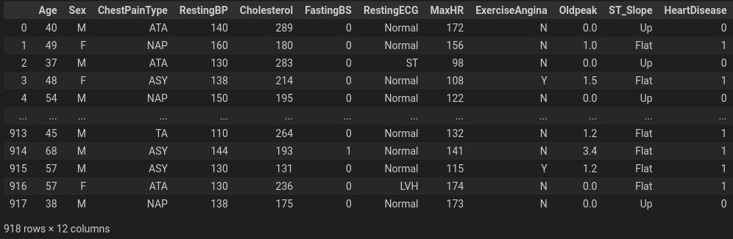
Heart Failure Prediction Data

Slide 3
Background Of The Dataset
This dataset was produced by merging many datasets that were previously available separately but had never been combined. This dataset is the largest heart disease dataset currently available for research reasons because it combines five heart datasets over eleven shared features. It was curated using the following five datasets. They had between 200 and 250 observations on average across the five datasets.

Slide 4
Hypothesis
Null:
The Heart disease failure dataset accurately predicts who is likely to have heart failure.
Alternative:
The Heart disease failure dataset does not accurately predict who has heart failure.

Slide 5
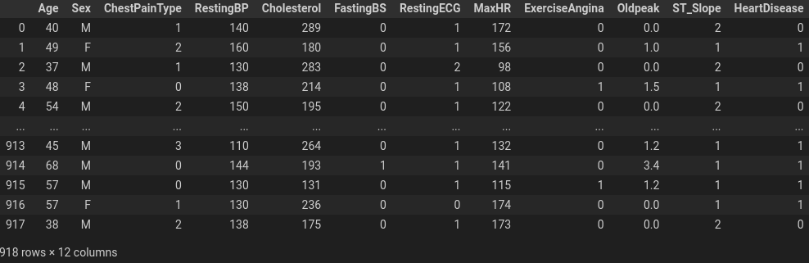
Preprocessing
One hot-encoding
Converted categorical values to numerical ones

Slide 6
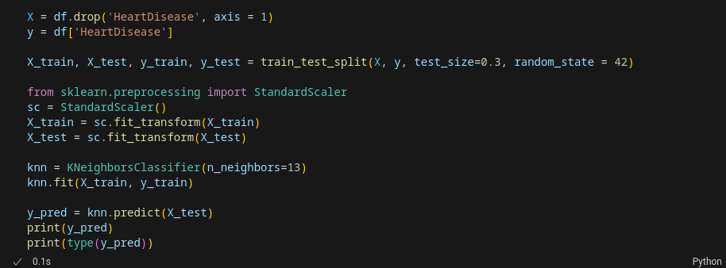
KNN

Slide 7
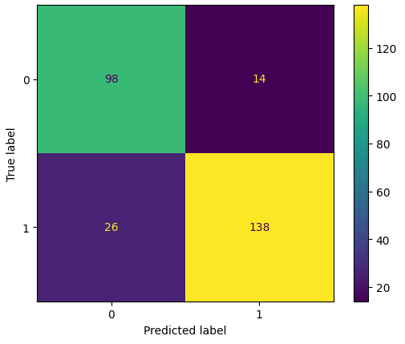
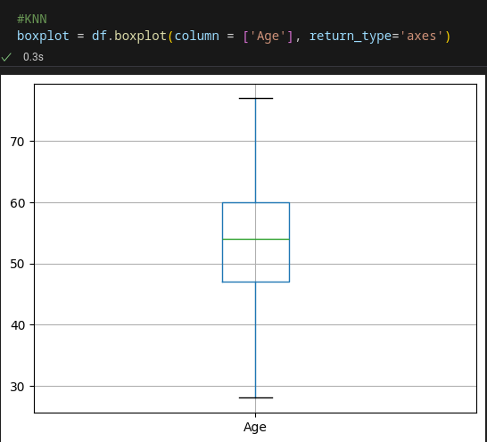
KNN(continued)

Slide 8
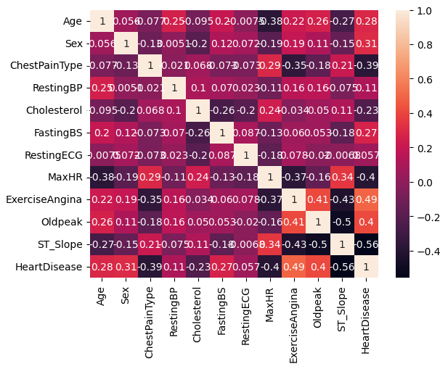
Heatmap

Slide 9
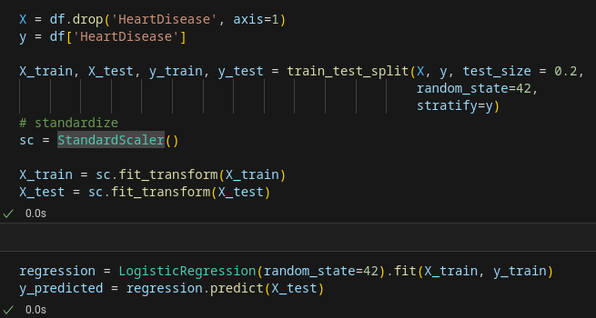

Logistic Regression

Slide 10
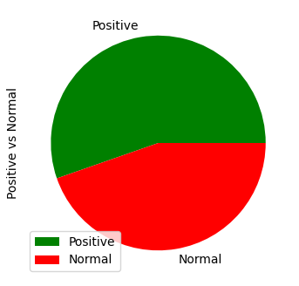
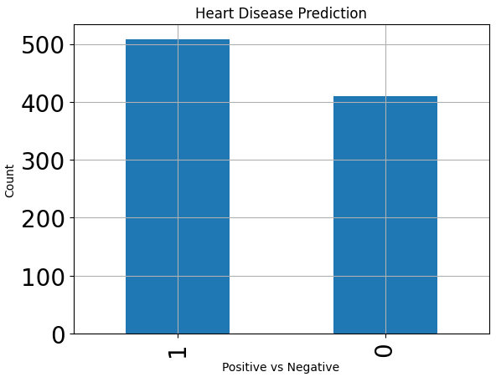
Charts

Slide 11
Conclusion
Logistic Regression and KNN
Hypothesis
Over or Undersampling?

